Slide 1
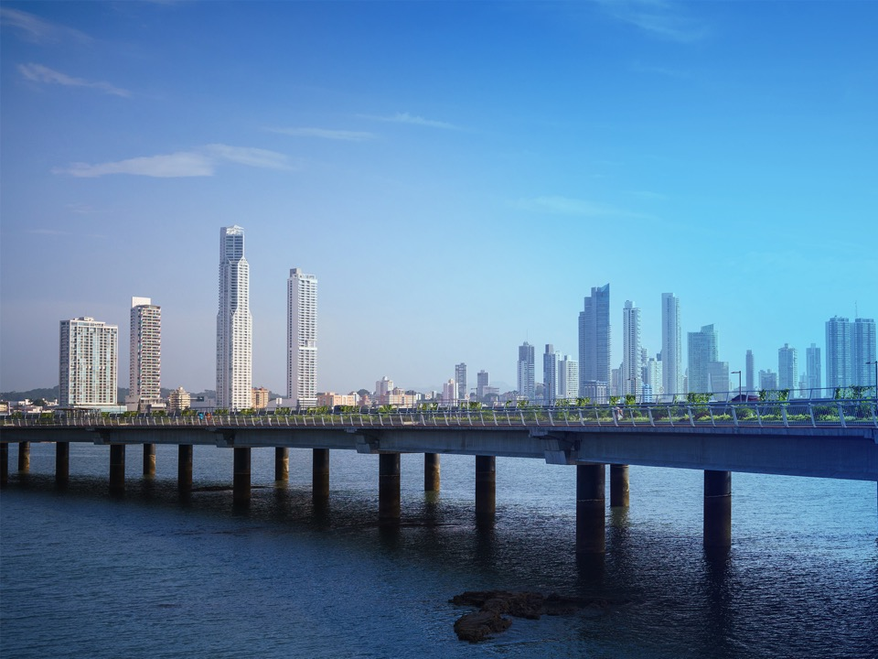
High Level Government
Meeting Update
25 June 2018

Slide 2
Session Goals:
Provide Background on The High Level Governmental Meeting
Update GAC on Logistical Highlights (Date, Arrangements, Invitations)
Review Agenda
Review Next Steps, To Do’s and Timeline
Notes:
Overview of expectations for the session.

Slide 3
1. Background – What is the “HLGM”?
Approximately once every two years one of the GAC Members hosts a High Level Governmental Meeting (HLGM) in conjunction with an ICANN meeting and in addition to the usual GAC meeting.
The concept grew out of recommendations made by previous Accountability and Transparency Review Teams (ATRT1 and ATRT2)
Previous HLGM’s have taken place in Toronto (ICANN45), London (ICANN50) and Marrakesh (ICANN55).
Notes:
Presenter – GAC Chair

Slide 4
1. Background – What is the “HLGM”?
The HLGM provides the opportunity to:
Reaffirm the critical role that governments play in providing advice to the ICANN Board on public-policy issues as it relates to the secure and stable functioning of the Domain Name System.
Enable all parties to gain a clearer understanding of the role of governments in ICANN processes, including the GAC.
Discuss current public policy issues and challenges at very senior level. These discussions can occur between government and government, as well as between governments and the ICANN leadership group.
Expose very senior administrative officials and senior elected officials (Ministers, members of legislative bodies) to ICANN, allowing them to gain a greater understanding of the organization and the issues it deals with. In turn, this may lead to better support for and resourcing of GAC representatives within their home administrations.
Reach out to administrations and governments who are not yet, or not currently, represented on the GAC or in other ICANN forums.
Notes:
Presenter – GAC Chair

Slide 5
2. Logistical Highlights (Date, Arrangements, Invitations)
ICANN 63: 20 - 26 October 2018
Venue: Barcelona International Convention Centre (CCIB)
HLGM : 22nd October (Monday)
Lunch for Ministers, Head of Delegations and ICANN officials
Host invitations letters sent in May followed by email
Twenty-three delegations have already RSVP’d
Plan for post-Panama reminder renewing invitation, and later, request for speaker volunteers
Targeted Travel Support (approx. 20 slots based on funding)
Notes:
Presenter Spain

Slide 6
3. Agenda Development
Open Discussion/suggestions on Topics or Theme from GAC membership at both ICANN60 (Abu Dhabi) and ICANN61 (San Juan)
Written GAC input on draft agenda solicited after ICANN61
Further planning team refinements
Final Agenda circulated to GAC membership last week

Slide 7
3. Basic Agenda Framework
Introductions – Spanish Minister of Economy and Enterprise
Session 1. The Role of and Opportunities For Governments in ICANN – Post IANA Transition
Session 2. Thematic Challenges in the IG Ecosystem – Cybercrime, Data Protection and Privacy
Lunch – ITU Secretary General
Session 3. The Internet Technological Evolution and the Role of ICANN
Session 4. Global Digital Agenda and Internet Policies
Closing remarks
Reception

Slide 8
3. Agenda Details
Session 1. The Role of and Opportunities For Governments in ICANN – Post IANA Transition
Potential discussion points:
Discussion of Governments and Intergovernmental Organizations´ participation in ICANN: incorporating the public policy perspective into ICANN policy development
How is the model working for governments? (in the context of the empowered community model)
Taking stock: the role of governmental and intergovernmental participation in the GAC
Potential Impact of governments making laws and regulations on DNS/ICANN
Explore the multi-stakeholder model and multi-stakeholder approaches to Internet governance,

Slide 9
3. Agenda Details
Session 2. Thematic Challenges in the IG Ecosystem – Cybercrime, Data Protection and Privacy
Potential discussion points:
Seeking balance between the desire to protect privacy and the need to combat cybercrime
security vs privacy or freedom of expression
potential for fragmentation of the Internet
Role of the Domain Name System community and WHOIS in combatting cybercrime
Potential update on GDPR implementation

Slide 10
3. Agenda Details
Session 3. The Internet Technological Evolution and the Role of ICANN
Potential discussion points:
DNS in the emerging technology space –
Potential impacts of blockchain technology, Internet of Things, 5G and Artificial Intelligence;
Outreach by ICANN to ensure a single stable secure resilient Internet (e.g., capacity building efforts and universal acceptance)
Role of ccTLDs – maximizing their value for local internet communities
Session 4. Global Digital Agenda and Internet Policies
Potential discussion points:
What is the role of governments in developing a digital economy in their own countries?
Needs of emerging economies and digital agenda
Role of IDNs in offering a better access to the Internet
ICANN’s technical role to help “leapfrog” the digital agenda

Slide 11
3. Agenda – Speaking Opportunities
Attending delegations are invited to seek specific comment/discussion slots in the topic areas of interest outlined for each session.
Delegations are kindly requested to plan for one to three (3) minute statements for any session in which they have an interest. Efforts will be made to accommodate all requests.
Due to overall meeting time limits, if a delegation has an interest in requesting time slots for more than one session, the delegation is asked to indicate its topic order of preference - as preference will be given to delegations who have not yet spoken during the program.
Host country will send an e-mail requesting applications for speaking slots.
Meeting planners will be flexible in managing the timing of each session to accommodate the interest level of attendees.
Session timing for the meeting day may be adjusted closer to the actual meeting date to reflect the overall interest in each topic – as indicated by speaking slot requests.

Slide 12
4. HLGM Planning – GAC Representative Support
Update and Invitation renewal will be sent shortly after Panama
Please share updated information within your government (e.g., agenda and speaking opportunities)
Coordination and Support of Invitations By GAC Representatives:
Confirm delivery of invitations to appropriate parties
Reach out to High Level Officials and make case for attendance in Barcelona.
Assist with RSVP information (informing organizers asap)
Planning attendance logistics (potential support)
Coordinate interest in any speaking roles for your official
Start visa arrangements as soon as possible
See you in Barcelona!
Notes:
Presented by GAC Chair

Slide 13
Thank You

